Slide 1
Operational Suitability Data
ROMANIAN CIVIL AERONAUTICAL AUTHORITY
1
1
AACR - Ședință standardizare – București – Iunie 2018
Notes:
In case of emergency, please use the door you came in because, even that we are at the ground floor, outside the windows is a quite deep ditch.
The emergency phone is of course, 112.

Slide 2
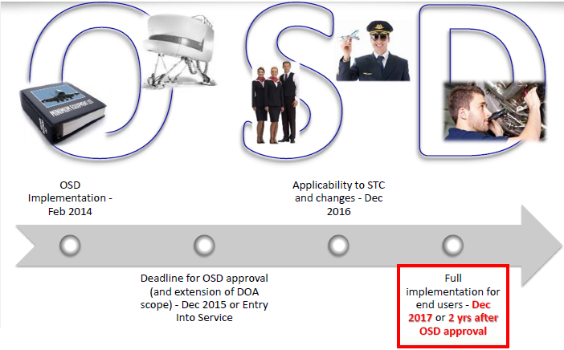
2
AACR - Ședință standardizare – București – Iunie 2018

Slide 3
3
AACR - Ședință standardizare – București – Iunie 2018

Slide 4
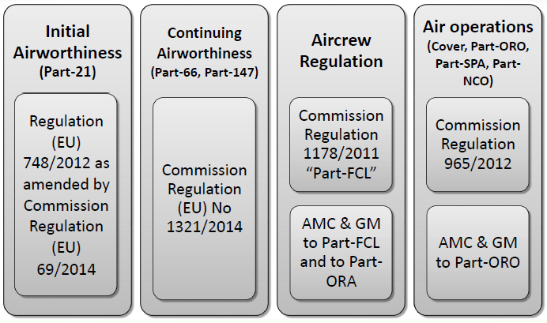
4
AACR - Ședință standardizare – București – Iunie 2018

Slide 5
Operational Suitability Data
Regulamentul (UE) 965/2012 – Cover:
Article 9
Minimum equipment lists
After the entry into force of this Regulation any change to the MEL referred to in the first subparagraph for which a Master Minimum Equipment List (‘MMEL’) is established as part of the operational suitability data… shall be made in compliance with point ORO.MLR.105 of Section 2 of Annex III to this Regulation at the earliest opportunity and not later than 18 December 2017 or two years after the operational suitability data was approved, whichever is the latest.
5
AACR - Ședință standardizare – București – Iunie 2018

Slide 6
Operational Suitability Data
Regulamentul (UE) 965/2012 – Cover:
Article 9a
Flight and cabin crew training
Operators shall ensure that flight crew and cabin crew members who are already in operation and have completed training in accordance with Subparts FC and CC of Annex III which did not include the mandatory elements established in the relevant operational suitability data, undertake training covering those mandatory elements not later than 18 December 2017 or two years after the approval of the operational suitability data, whichever is the latest.
6
AACR - Ședință standardizare – București – Iunie 2018

Slide 7
Operational Suitability Data
Regulamentul (UE) 965/2012 – ORO.MLR:
A minimum equipment list (MEL) shall be established as specified under point 8.a.3 of Annex IV to Regulation (EC) No 216/2008, based on the relevant master minimum equipment list (MMEL) as defined in the data ... If an MMEL has not been established as part of the operational suitability data, the MEL may be based on the relevant MMEL accepted by the State of Operator or Registry as applicable.
7
AACR - Ședință standardizare – București – Iunie 2018

Slide 8
Operational Suitability Data
Regulamentul (UE) 965/2012 – ORO.FC:
ORO.FC.145 Provision of training
(b) When establishing the training programmes and syllabi, the operator shall include the relevant elements defined in the mandatory part of the operational suitability data..…
AMC1 ORO.FC.145(b) Provision of training
NON-MANDATORY (RECOMMENDATION) ELEMENTS OF OPERATIONAL SUITABILITY DATA
When developing the training programmes and syllabi, the operator should consider the non mandatory (recommendation) elements for the relevant type that are provided in the operational suitability data…..
8
AACR - Ședință standardizare – București – Iunie 2018

Slide 9
Operational Suitability Data
Regulamentul (UE) 965/2012 – ORO.FC:
ORO.FC.140 Operation on more than one type or variant
Flight crew members operating more than one type or variant of aircraft shall comply with the requirements prescribed in this Subpart for each type or variant, unless credits related to the training, checking, and recent experience requirements are defined in the mandatory part of the operational suitability data….
9
AACR - Ședință standardizare – București – Iunie 2018

Slide 10
Operational Suitability Data
Regulamentul (UE) 965/2012 – ORO.FC:
AMC1 ORO.FC.220 Operator conversion training and checking
For specific operations, such as steep approaches, ETOPS, or operations based on QFE, additional training should be carried out, based on any additional elements of training defined for the aircraft type in the operational suitability data …., where they exist.
10
AACR - Ședință standardizare – București – Iunie 2018

Slide 11
Operational Suitability Data
Regulamentul (UE) 965/2012 – ORO.CC:
ORO.CC.125 Aircraft type specific training and operator conversion training
(b) When establishing the aircraft type specific and the operator conversion training programmes and syllabi, the operator shall include, where available, the relevant elements defined in the mandatory part of the operational suitability data ....
ORO.CC.130 Differences training
(c) When establishing a differences training programme and syllabus for a variant of an aircraft type currently operated, the operator shall include, where available, the relevant elements defined in the mandatory part of the operational suitability data ....
11
AACR - Ședință standardizare – București – Iunie 2018

Slide 12
Operational Suitability Data
Regulamentul (UE) 965/2012 – ORO.CC:
AMC1 ORO.CC.125(b) & ORO.CC.130(c) Aircraft type specific training and operator conversion training & differences training
NON-MANDATORY (RECOMMENDATIONS) ELEMENTS OF OPERATIONAL SUITABILITY DATA
When developing the training programmes and syllabi for aircraft-type specific training and for differences training, the operator should consider the non-mandatory (recommendations) elements for the relevant type that are provided in the operational suitability data .….
12
AACR - Ședință standardizare – București – Iunie 2018

Slide 13
Operational Suitability Data
Regulamentul (UE) 965/2012 – ORO.CC:
ORO.CC.250 Operation on more than one aircraft type or variant
…. the operator shall determine:
(1) each aircraft as a type or a variant taking into account, where available, the relevant elements defined in the mandatory part of the operational suitability data
(2) …..
13
AACR - Ședință standardizare – București – Iunie 2018

Slide 14
Operational Suitability Data
Regulamentul (UE) 965/2012 – SPA.GEN:
SPA.GEN.105 Application for a specific approval
The operator shall provide the following evidence to the competent authority:
(1) compliance with the requirements of the applicable Subpart;
(2) that the relevant elements defined in the mandatory part of the operational suitability data …. are taken into account.
14
AACR - Ședință standardizare – București – Iunie 2018

Slide 15
Operational Suitability Data
Regulamentul (UE) 965/2012 – ORO.GEN:
ORO.GEN.160 Occurrence reporting
….the operator shall report to the competent authority and to the organisation responsible for the design of the aircraft any incident, malfunction, technical defect, exceeding of technical limitations or occurrence that would highlight inaccurate, incomplete or ambiguous information contained in the operational suitability data …. or other irregular circumstance that has or may have endangered the safe operation of the aircraft and that has not resulted in an accident or serious incident.
15
AACR - Ședință standardizare – București – Iunie 2018

Slide 16
Operational Suitability Data
Aşteptările AACR:
Până la data de 18 decembrie 2017 (sau la 2 ani de la aprobarea OSD) operatorii aerieni trebuie să asigure:
implementarea elementelor obligatorii referitoare la pregătirea FC şi CC;
conformarea MEL cu OSD MMEL;
Procesul de raportare a evenimentelor ar trebui deja adaptat pentru a semnala deficiențele OSD la AACR;
Operatorii ar fi trebuit să efectueze o analiză GAP pentru a se asigura că cel puțin elementele obligatorii sunt incluse în programele de pregătire și verificare a FC / CC (inițiale și recurente)
SMS dezvoltat de operatorul aerian trebuia să adreseze elementele non-mandatorii (recomandările) din OSD
16
AACR - Ședință standardizare – București – Iunie 2018

Slide 17
Operational Suitability Data
Acţiunile AACR:
Au fost solicitate documentele OSD de la producătorii de aeronave operate de operatorii aerieni români;
Instrucţiunile tehnice (proceduri interne, liste de verificare) au fost adaptate pentru a asigura competenţa inspectorilor în verificarea conformării cu OSD;
Verificarea conformării cu cerinţele referitoare la implementarea OSD a fost iniţiată din 2017.
17
AACR - Ședință standardizare – București – Iunie 2018

Slide 18
18
AACR - Ședință standardizare – București – Iunie 2018

Slide 19
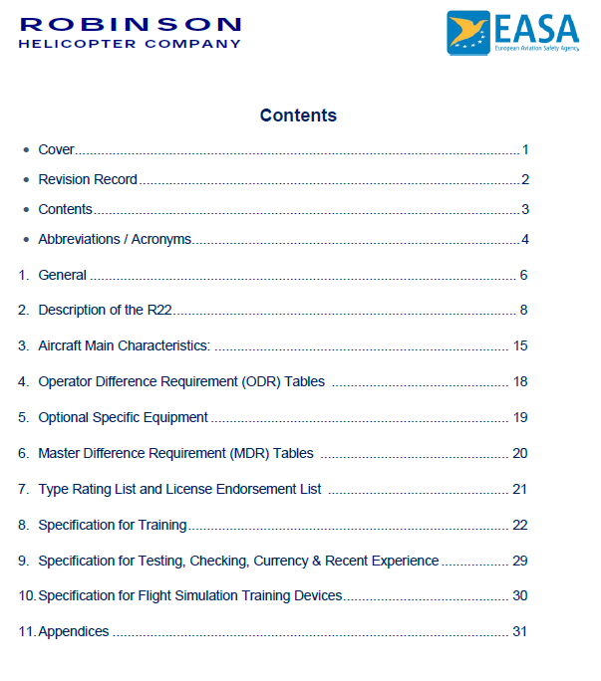
19
AACR - Ședință standardizare – București – Iunie 2018

Slide 20
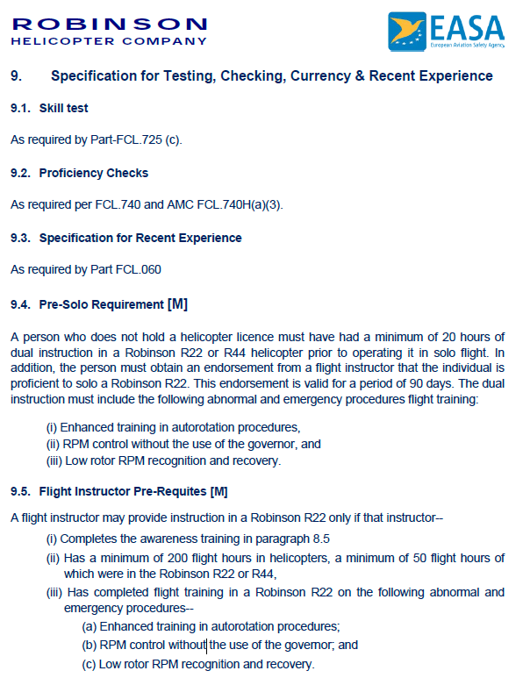
20
AACR - Ședință standardizare – București – Iunie 2018

Slide 21
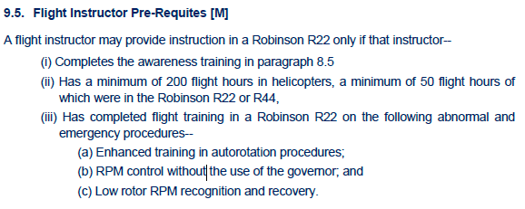
21
AACR - Ședință standardizare – București – Iunie 2018

Slide 22
22
AACR - Ședință standardizare – București – Iunie 2018

